Slide 1
User Perception and Usability
5CS020-HCI (Human Computer Interaction)
Week - Five
March, 2024

Slide 2
“The boundaries of design are the same as the problems of perception”
John Hench

Slide 3
Humans are complicated
We have been on earth for about ± 200,000 years
And our senses have evolved and fine tuned for survival
What we perceive is not the same as what we see
It is important to understand the difference
And it’s important to have guiding principles to streamline our thought and communication
Notes:
Humans are complicated animals.
And over thousands of years, our senses have evolved to ensure our survival
Especially our eyes and our sense of vision
What we see as light hitting our retina and what our brain perceives are two very different things
It is important to understand their differences, the difference between stimulus and perception
Especially so if we want to create efficient methods of visual communication
And we can’t simply wing it
We need to have guiding principles so that our thoughts and the way that we communicate with our peers is streamlined

Slide 4
Gestalt Principles of Perception
Gestalt: a German origin word
Literally translates to shape or form
Now the word represents a whole school of psychology
We have a more nuanced understanding of human visual perception because of it
Notes:
Gestalt is a german word. It literally translates to shape or form
But now the word has come to represent a whole school of psychology
And the effort that has been put into the gestalt school of psychology has led to a more nuanced understanding of human visual perception

Slide 5

Evolution is all about problem solving
The problem of survival
Notes:
For example, we have understood that the human senses have evolved to solve one particular problem. Survival

Slide 6
Evolution is all about problem solving
We had to instantly identify threats
Notes:
We had to instantly identify threats
We had to find one visual trait that was enough to identify a predator so that we could immediately start running in the opposite direction
We had no time to wait and look for stripes

Slide 7

Evolution is all about problem solving
We had to instantly identify threats
Notes:
And our brain chose silhouettes
And our visual perception really doubled down on identifying silhouettes

Slide 8
Evolution is all about problem solving
And we had to do it with partial information
Notes:
And since the threat could be visually obstructed, for example, behind trees, we got great at identifying silhouettes even with partial information

Slide 9

So we became great at visual extrapolation
Notes:
This greatly increased our ability to draw inferences and extrapolate based on limited information

Slide 10

In other words, filling in the gap
Notes:
In other words, we got great at filling in the gaps

Slide 11
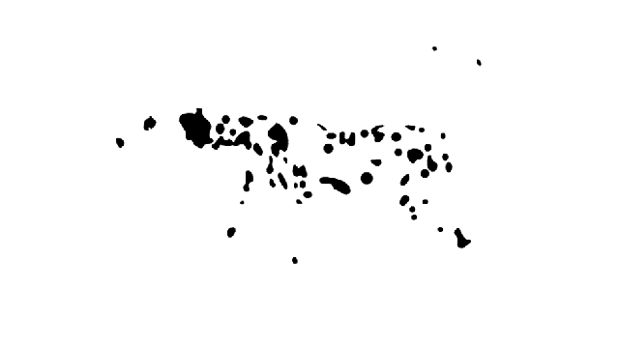
Notes:
In other words, we got great at filling in the gaps

Slide 12
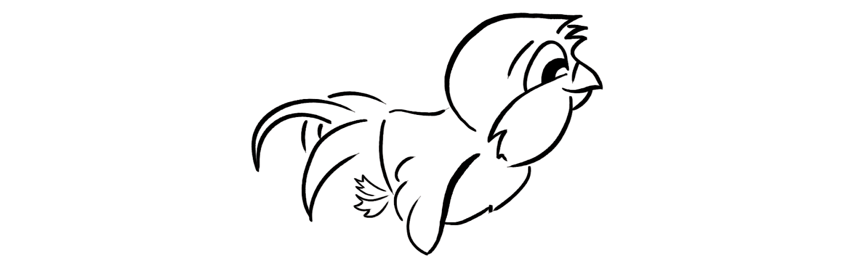
This understanding has changed multiple fields
Notes:
This knowledge about the human brain’s ability to instantly extrapolate information led to the evolution of multiple fields.
Let’s take this illustration of a bird for example.
In this frame, the bird has the wings facing down

Slide 13
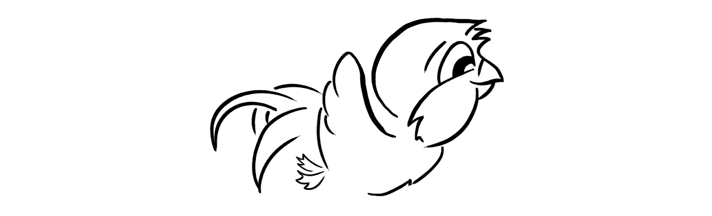
This understanding has changed multiple fields
Notes:
And in this frame the wings are facing upwards
Now if we cycle between the frames quickly, our brain will immediately fill in the movement and we can imagine the bird flapping its wings

Slide 14
Some practical Gestalt Principles
Similarity
Grouping
Figure-Ground
Proportion
Continuation
Area
There is no definitive list of Gestalt Principles. It varies from person to person and school to school.
Notes:
This ability of our brain to instantly extrapolate can be very useful in designing visual communication patterns
It is important to categorize these rules of perception to add more structure to our thoughts and working process
Now there is no definitive list of gestalt principles. It varies from person to person and school to school
But here are five practical principles that I found particularly useful.
Due to time constraints, I will only be discussing two of those.
Similarity and grouping

Slide 15
Similarity
Similar objects have similar uses or properties
Establishing similarity is a simple and effective way of communication
Usually used to establish visual cues using specific colors and other visual properties
Notes:
Similar objects have similar uses or properties. And this goes both ways. Objects with similar properties are assumed to have similar uses and objects with similar uses are expected to have similar properties.
Establishing similarity is a simple and effective way of communication
This principle is usually used to establish visual cues using specific colors and other visual properties

Slide 16
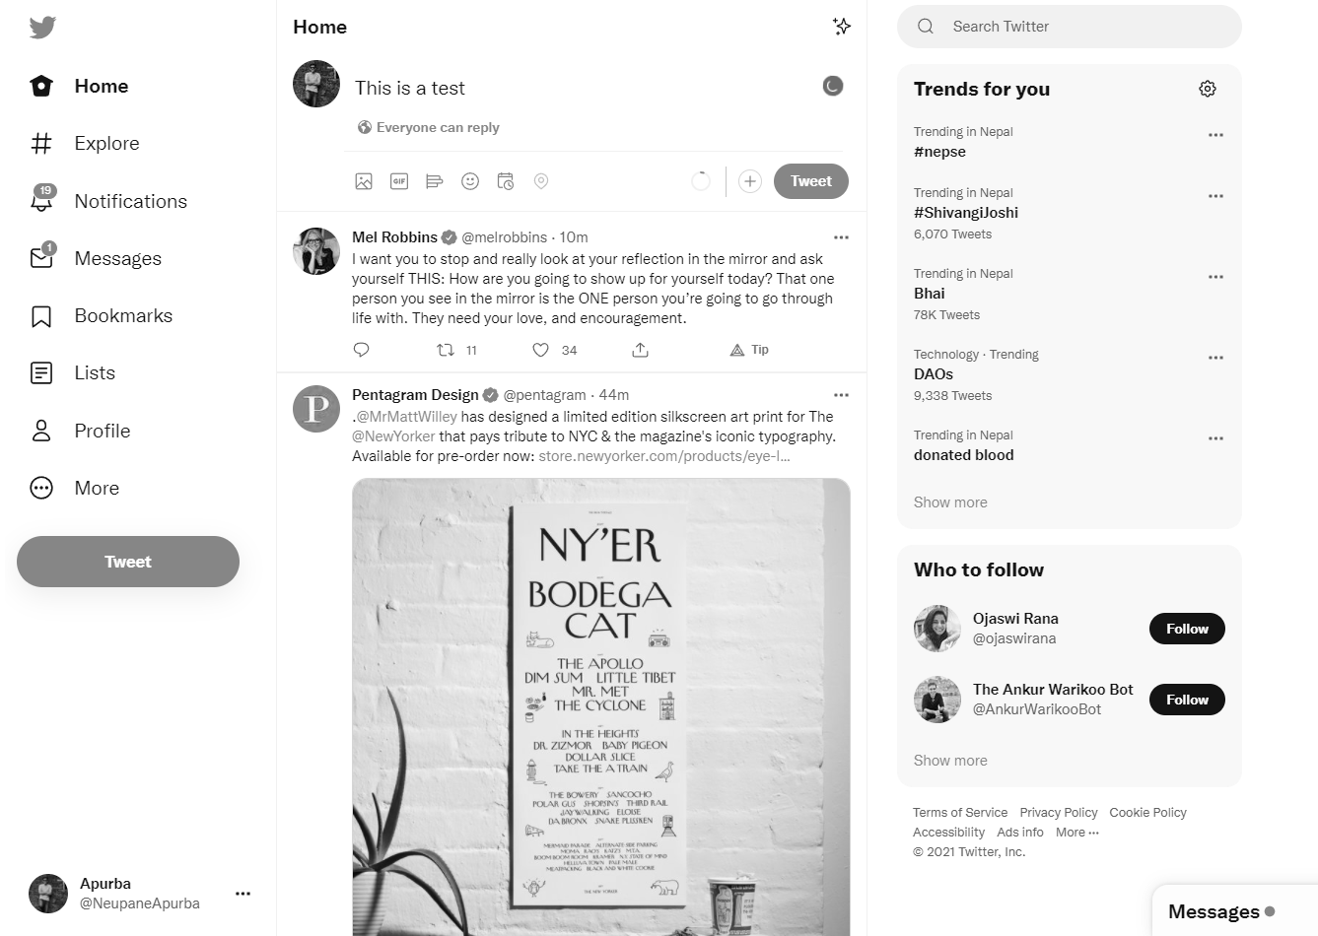
Primary Action Color
Notes:
To better understand the use of color that goes into the twitter UI, let’s take a look at the screen in black and white. It is much more difficult to interact with the platform this way.
It is difficult to differentiate which elements are information elements and which elements are interaction or action elements

Slide 17
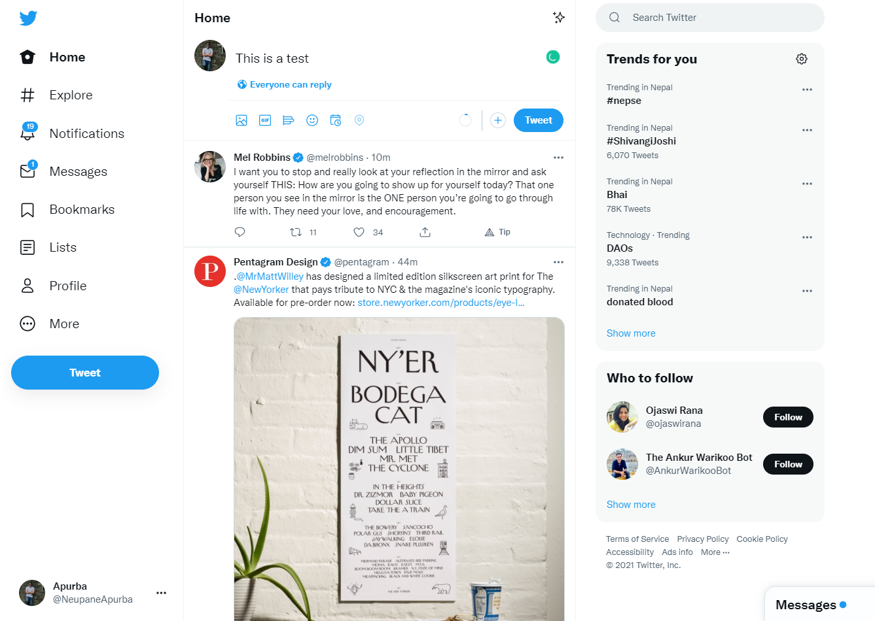
Primary Action Color
Notes:
But of course, that is no the case when we see the UI in color. We see that the elements that the user need to interact with all have the same color, or the same family of colour.
This helps for the user’s eye to travel the screen and scan for areas to interact with

Slide 18
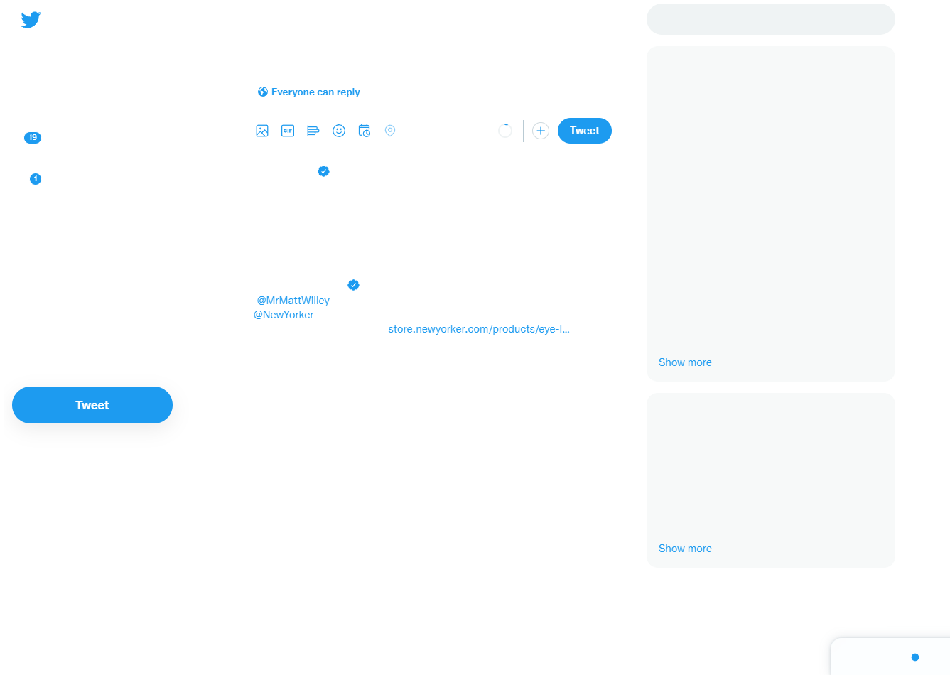
Primary Action Color
Notes:
And by using this colour diligently in all its primary actions, the user’s attention is easily drawn to these colors. Which in turn enables twitter to dictate the user behaviour to a certain extent. Most of the areas where the primary action colour is used in the twitter UI are areas which lead to the user interacting more and more with the platform in general.

Slide 19
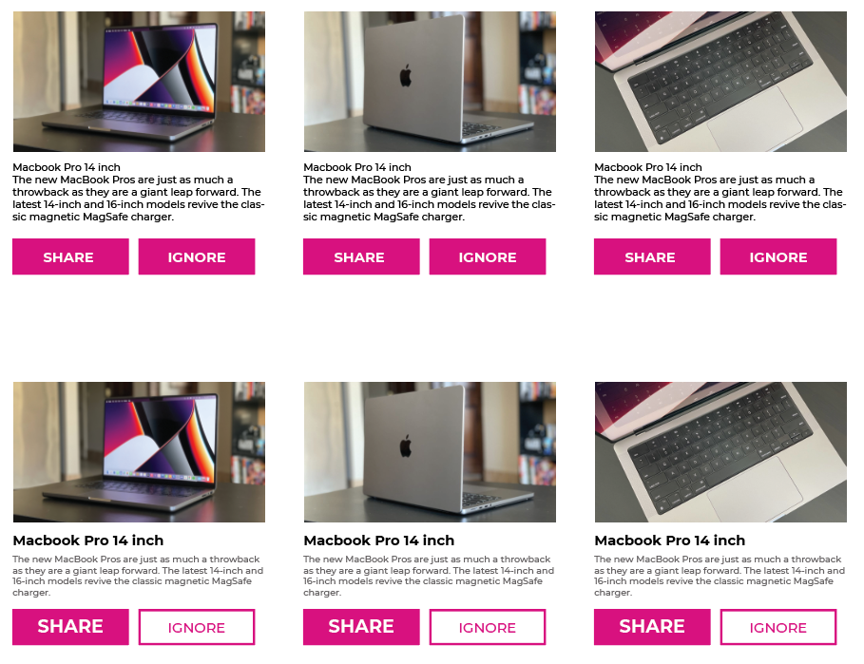
Layout Design
Notes:
Another example of using similarity is while designing a group of elements.
If we make different elements with varying hierarchy have the same visual language, it takes time for our brain to process that information.
However, if we make elements vary based on different visual languages, our brain can scan for information much more easily

Slide 20
Grouping
By grouping different objects, we can establish a connection
The objects may be visually similar or different
The groups can be made either through enclosure and/or proximity
Notes:
Similarity works when elements are visually similar. But we can still establish connection between visually different elements.
That works by grouping the elements together
The grouping can be done by utilizing enclosure and/ or proximity

Slide 21

Proximity
Notes:
Proximity is the space between elements

Slide 22
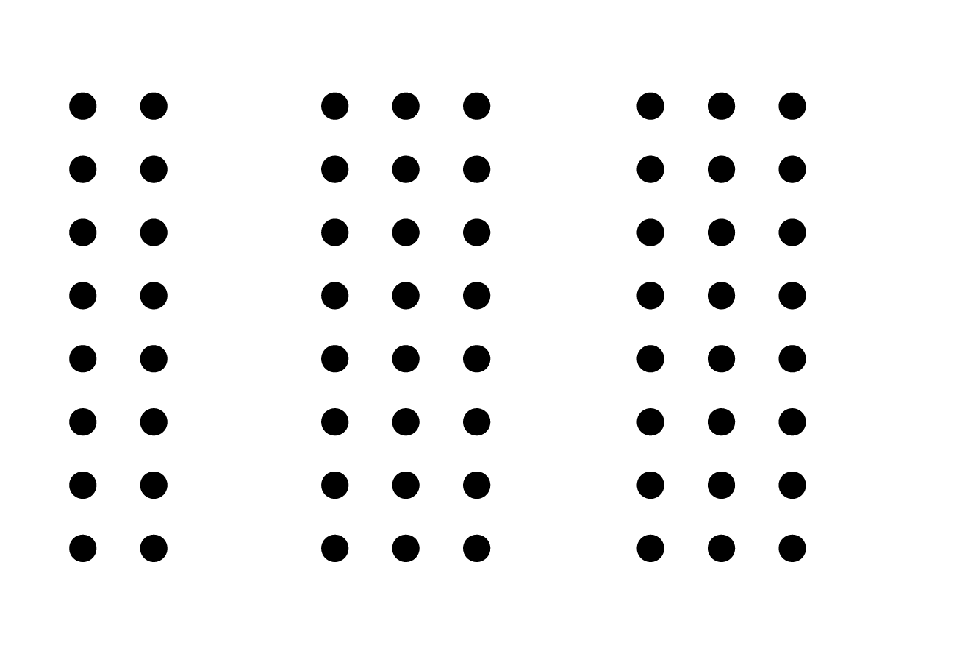
Proximity
Notes:
If we increase the space between some group of elements, they are perceived to be different in some respect

Slide 23
Enclosure
Notes:
Enclosure is the visual definition of boundaries

Slide 24
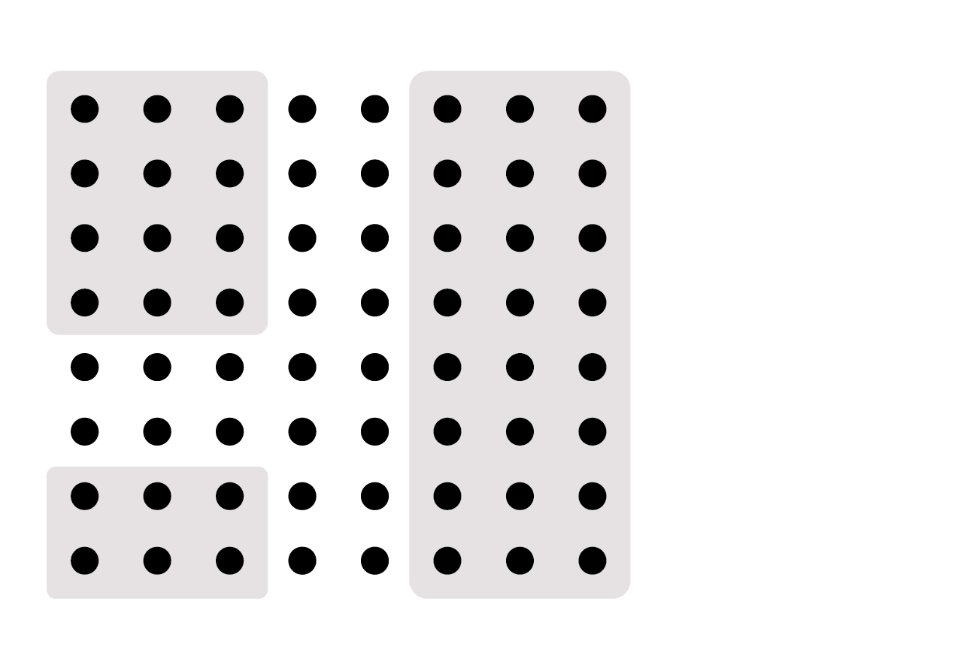
Enclosure
Notes:
When we enclose the elements in some respective shapes, there is a suggested connection between those elements

Slide 25
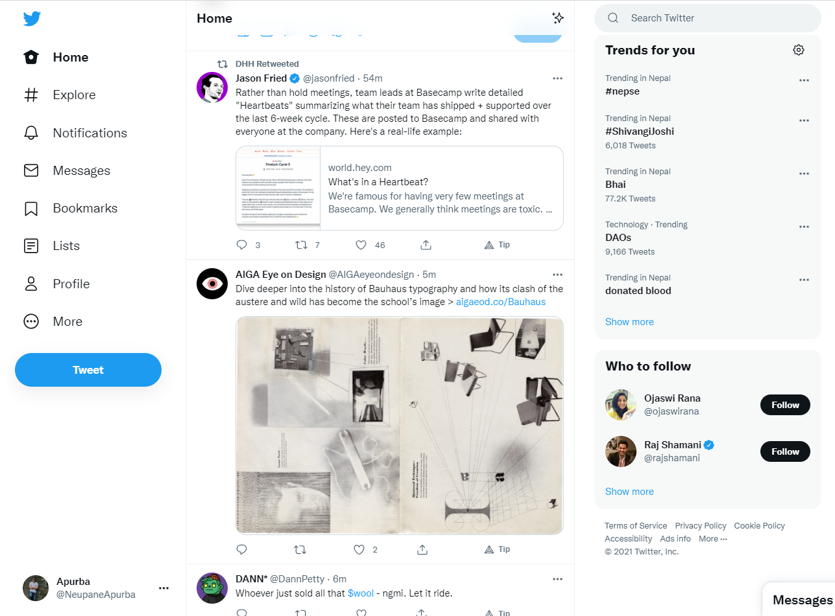
Grouping in UI Design
Notes:
Enclosure and Proximity are widely used in various real world designs

Slide 26
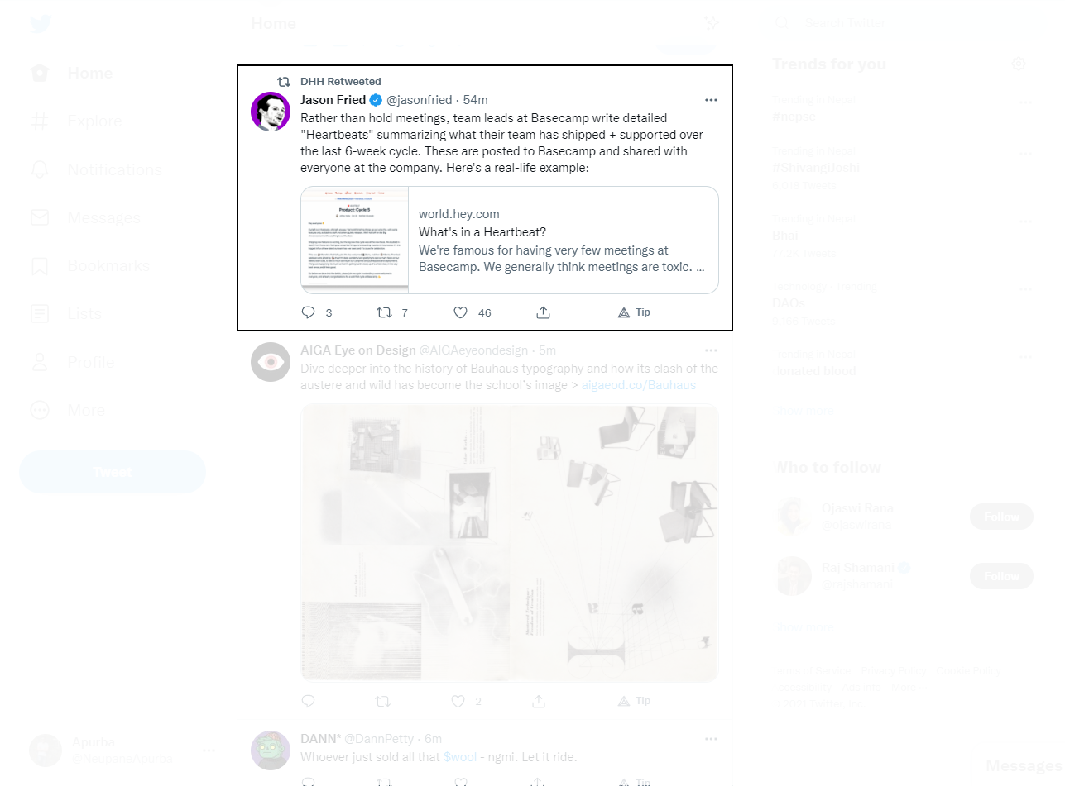
Grouping in UI Design

Slide 27
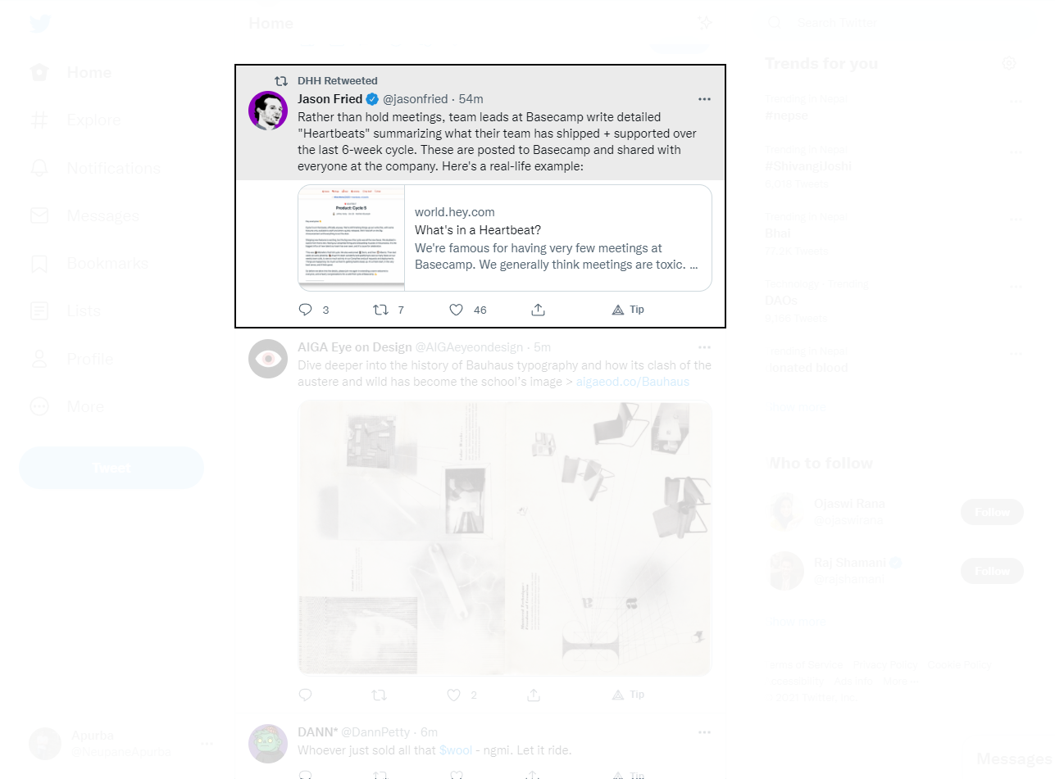
Grouping in UI Design

Slide 28
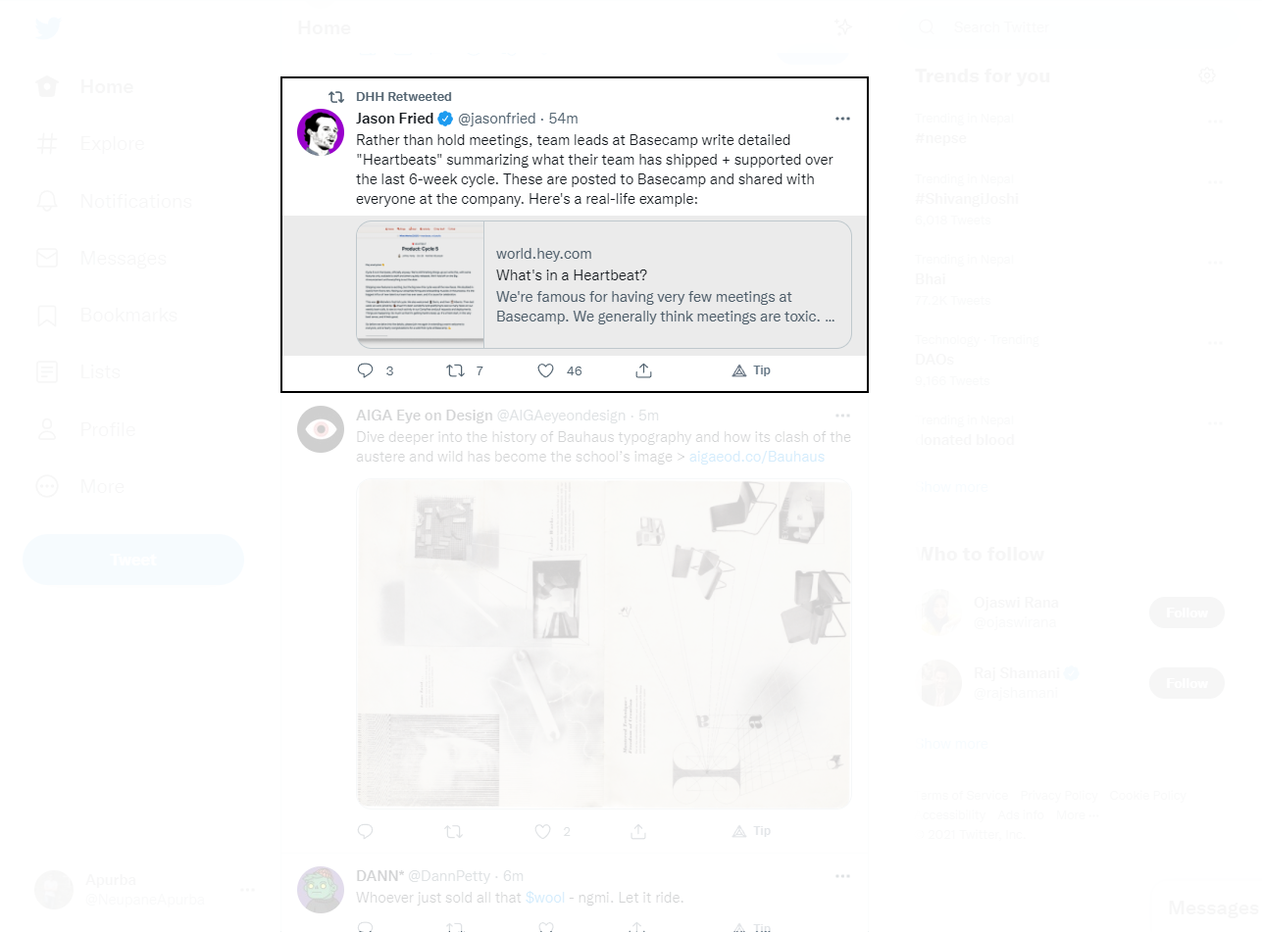
Grouping in UI Design

Slide 29
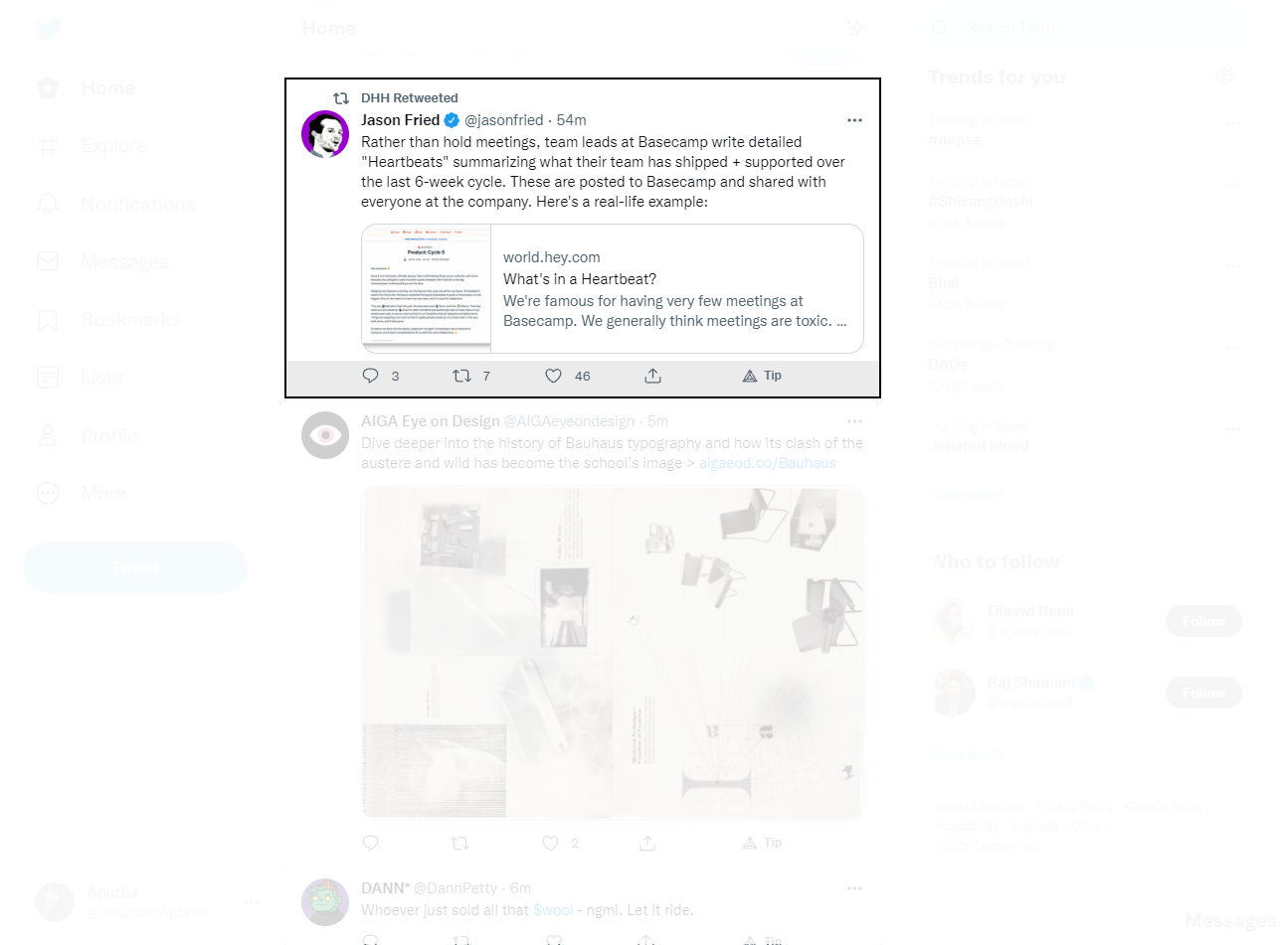
Grouping in UI Design

Slide 30
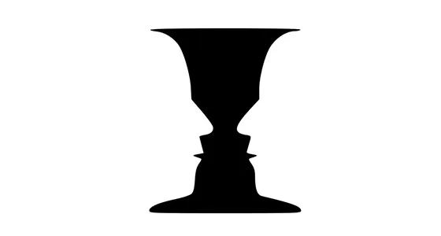
Figure ground
We perceive our environment by differentiating between objects and their background
Rubin Face/ Vase Illusion
https://www.interaction-design.org/literature/article/the-laws-of-figure-ground-praegnanz-closure-and-common-fate-gestalt-principles-3

Slide 31
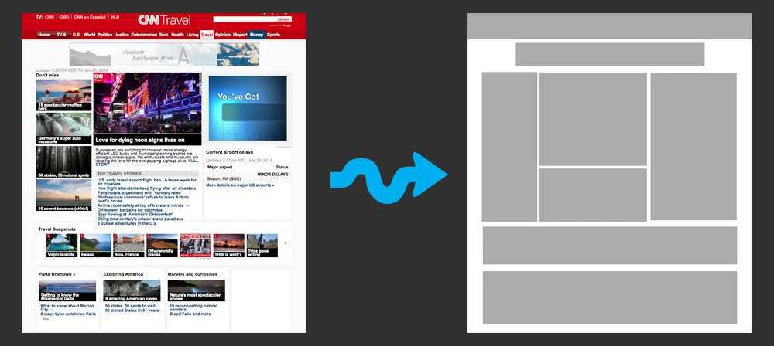
https://www.interaction-design.org/literature/article/the-laws-of-figure-ground-praegnanz-closure-and-common-fate-gestalt-principles-3

Slide 32
Proportion
Proportions can be used to represent logical hierarchies
Heading Level 1
Heading Level 2
Heading Level 3
Heading level 4
Heading Level 5
Heading Level 6

Slide 33
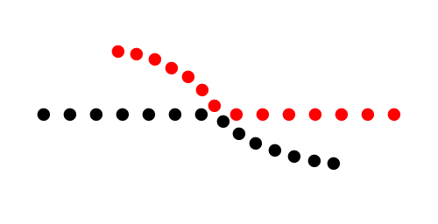
Continuity
Notes:
In the image above, the red dots in the curved line seem to be more related to the black dots on the curved line than to the red dots on the straight horizontal line.
That’s because our eye naturally follows a line or a curve, making continuation a stronger signal of relatedness than the similarity of color.

Slide 34
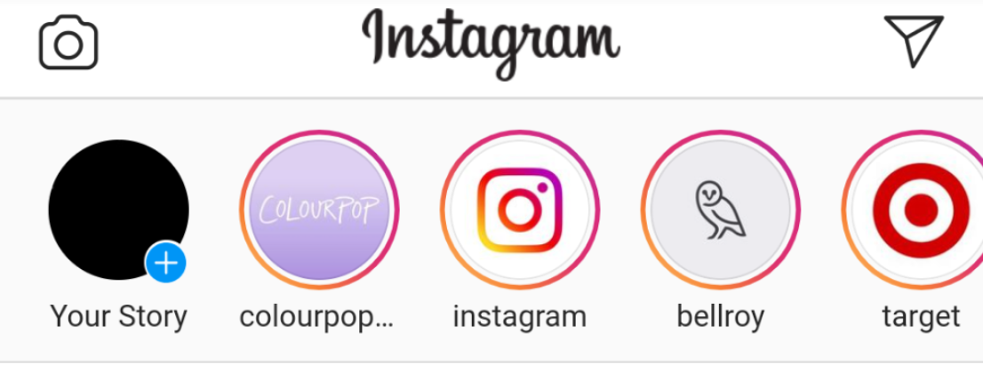
Continuity
Notes:
Story section of instagram is a good example
Some images have outlines, some don’t. All images are different. But since they move together, we think of them as a single collection od related elements

Slide 35
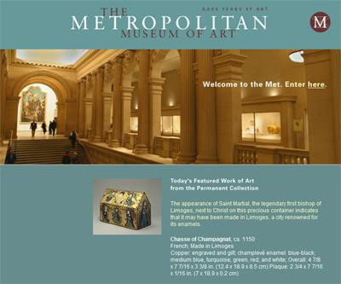
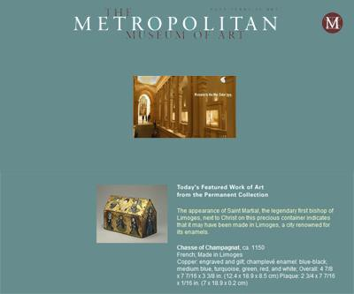
Area
Object with the smaller area is the figure, not the ground

Slide 36
There needs to be a box for out of the box thinking

Slide 37
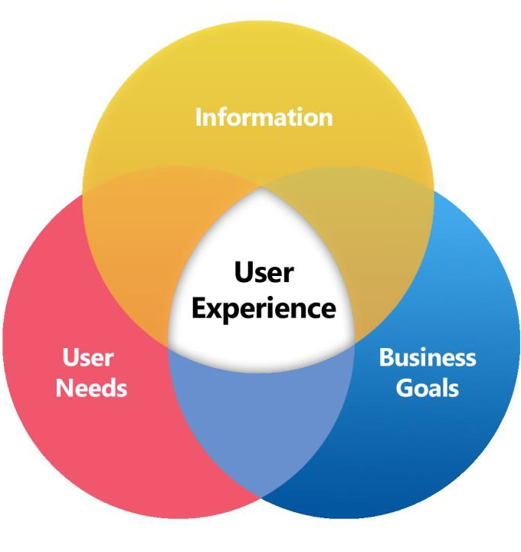
https://commons.wikimedia.org/wiki/File:User-experience-diagram.png

Slide 38
What is Usability?
It is a measure
How well a design is able to achieve its purpose
Mugs
E-commerce Websites
What makes something usable?
What are the design criteria?
Notes:
Usability is a measure of how well a specific user in a specific context can use a product/design to achieve a defined goal effectively, efficiently and satisfactorily.
Effectiveness
Does it do the right thing?
Does it gets things done?
Efficiency
Does it do that with minimum effort (mental and physical)?
Satisfaction
Does it make you feel good?
Do you feel happy?
[ Video : https://www.interaction-design.org/literature/topics/usability]
[More reads: https://www.interaction-design.org/literature/topics/usability]

Slide 39
Why aren’t all mugs the same?

Slide 40


https://www.pepperfry.com/cdi-pipe-shaped-beer-mugs-400-ml-set-of-2-1752629.html
https://www.craftcoffeeguru.com/coffee-mug-for-home-and-travel/

Slide 41
Usability is always about Users
Human Centered Design
An approach to problem solving
Involves a human-perspective approach in all steps of problem solving

Slide 42
Users and Usability
Who are the users?
What do the users want?
When will they want it?
Where will they be?
Questions that help empathize with the user

Slide 43
Computing Environments
Physical
Social
Cognitive
Factors regarding the users’ environment
Notes:
User Experience is everywhere.
Link : https://www.geeksforgeeks.org/computing-environments-in-human-computer-interaction/

Slide 44
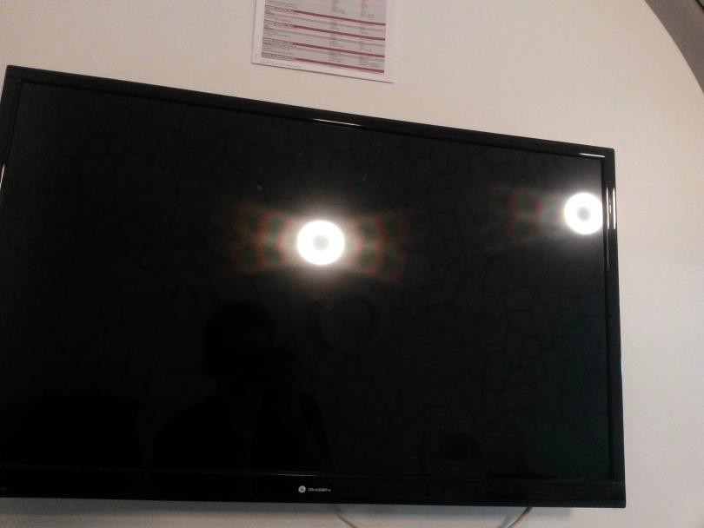
Physical Computing Environment
User Space
Work Space
Efficiency
Lighting
Safety
Noise
Pollution
https://physics.stackexchange.com/questions/160319/rainbow-%20%20reflected-on-tv-screen-pic-attached
Notes:
Physical Computing Environment :
Physical Computing Environment involves the hardware components, lighting facility, etc. It will affect various aspects of interaction design between components and other users. Personal Digital Assistants (PDA) are mobile, personal information appliances used for several purposes. Automatic Teller Machine (ATM) is fixed, public computing station used to perform financial operations.
Safety – This is an important issue in activities involving personal and confidential information such as bank details, mobile number, etc. Computer related errors and other errors should be minimized as much as possible.
Efficiency – Systems should not make user work more which will thereby reduce its efficiency.
User Space – There should be enough space for user to work comfortably. Sufficient amount of flexibility should be provided to user so that he can adjust things according to his comfort.
Work Space – User should be able to carry work objects such as notebooks, pens, etc to place if needed.
Lighting – Ambient illumination has to be maintained so that it doesn’t disrupt user’s work. Lighting system should be well controlled as per surroundings.
Noise – Disturbing noises should be reduced as much as possible for user to work effectively and conveniently.
Pollution – In some industrial areas, due to a lot of pollution machinery doesn’t work properly. Proper cleaning facility should be provided for the maintenance of machinery.

Slide 45
Social Computing Environment
Social settings impact computer usage
Computers also impact social interactions
Laptops rarely used in social settings
Phones extensively used in social settings
Notes:
This deals with how is system setup and how is interaction done.
For ATM and other personal transactions, a separate isolated space should be provided for safety.
Audible negative feedbacks can be embarrassing in public places, which should be avoided.

Slide 46
Cognitive Computing Environment
Age
Social Background (Nationality, etc.)
Disabilities
Degree of technical knowledge
Degree of focus
Cognitive Stress
Notes:
Cognitive : involving conscious intellectual activity
3. Cognitive Computing Environment :
Cognitive dynamic features should be considered in human-computer interaction design systems. Factors such as age, disabilities, etc play a major role in system design. The following points to be considered are –
Age – Some systems are specifically designed for children based on their cognitive ability. It’s easy for them to use and comprehend. Few systems are designed for adults which might be complex in nature.
Conditions related to disabilities – To be usable by a wider group of people, several disability factors should be kept in mind. For people having difficulty in seeing, auditory medium should be provided.
Degree of technical knowledge – There should be a requirement of minimal technical knowledge to use system by general users. For task-specific and complex operations, technicians are involved.
Degree of focus – There should be ease of use and user should not be asked to focus solely on system. The multitasking option should be enabled.
Cognitive stress – Different levels of cognitive stress is involved in different operations, ranging from mission-critical tasks to leisure time activities. Extra attention should be given to medical, defense, and important operations.

Slide 47
We need to abandon the Software Developer mindset and take the Interface Developer mindset

Slide 48
Software developers
What can I easily build on this platform?
What can I create from the available tools?
Testing the system - looks at functionality
Interface developers
Is the interface fit for its purpose?
Are there any specific problems with the interface?
Testing the interface
Usability, not functionality

Slide 49
Interface Developer’s Perspective
Design needs to be based upon a user’s
Abilities and real needs
Context
Work
Tasks
Need for usable and useful products

Slide 50
Usability, not functionality

Slide 51
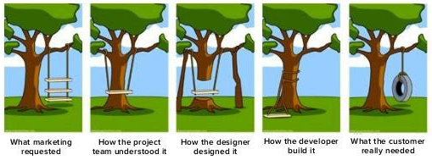
User Centered Design
We cannot forget the user
https://medium.com/@atmb4u/software-blueprint-57a551c6472b

Slide 52
User Centered Design
We cannot forget the user
https://medium.com/@atmb4u/software-blueprint-57a551c6472b

Slide 53
User Centered Design
We cannot forget the user
https://medium.com/@atmb4u/software-blueprint-57a551c6472b

Slide 54
User Centered Design
We cannot forget the user
https://medium.com/@atmb4u/software-blueprint-57a551c6472b

Slide 55
User Centered Design
We cannot forget the user
https://medium.com/@atmb4u/software-blueprint-57a551c6472b

Slide 56
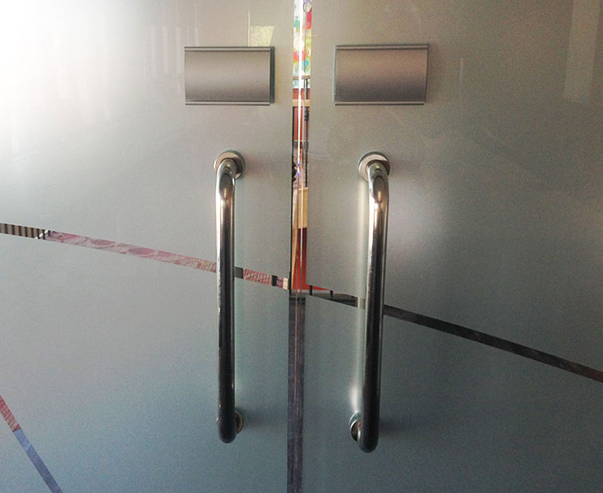
Usability Evaluation
Consider an everyday item
Who is going to use them?
To do what?
Where?
Why was it designed?
Are the designs successful?
Is this a “PULL” or a “PUSH” door?
https://www.internetrix.com.au/blog/frustrating-doors-and-the-principles-of-human-centred-design/

Slide 57
